Slide 1
Capstone Engagement
Assessment, Analysis, and Hardening of a Vulnerable System

Slide 2
Table of Contents
This document contains the following sections:
01
Network Topology
02
Red Team: Security Assessment
03
Blue Team: Log Analysis and Attack Characterization
Hardening: Proposed Alarms and Mitigation Strategies
04

Slide 3
Network Topology
‹#›

Slide 4
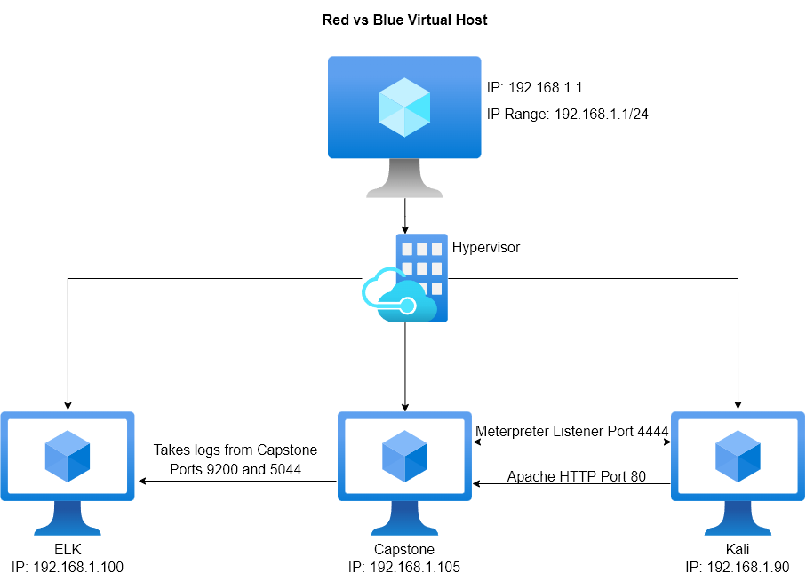
Network Topology
Network
Address Range: 192.168.1.1/24
Netmask: 255.255.255.0
Gateway: 10.0.0.1
Machines
IPv4: 192.168.1.1
OS: Windows
Hostname: ML-RefVm-684427
IPv4: 192.168.1.105
OS: Linux (Ubuntu)
Hostname: server1 (Capstone)
IPv4: 192.168.1.100
OS: Linux (Ubuntu)
Hostname: ELK
IPv4: 192.168.1.90
OS: Linux (Kali)
Hostname: Kali

Slide 5

Red Team
Security Assessment
‹#›

Slide 6
Recon: Describing the Target
Nmap identified the following hosts on the network:
Hostname | IP Address | Role on Network
ML-RefVm-684427 | 192.168.1.1 | This is the Windows machine that hosts all of the other virtual machines.
server1 (Capstone) | 192.168.1.105 | This is our target machine that we are to exploit and find the flag on
ELK | 192.168.1.100 | This machine is responsible for collecting the logs from the Capstone machine to use in Kibana
Kali | 192.168.1.90 | This the machine we are using to carry out the attack on the Capstone machine

Slide 7
Vulnerability Assessment
The assessment uncovered the following critical vulnerabilities in the target:
Vulnerability | Description | Impact
Local File Inclusion (LFI) Vulnerability | LFI allows access into confidential files/directories on a site. | This LFI vulnerability allowed access to credentials found on hidden files.
Brute Force Attack Vulnerability | Brute forces guess the passwords for employees through trying thousands of different options. | This brute force found a password for Ashton. This led us to gathering info only she had.
PHP Reverse Shell Vulnerability | After opening a PHP file a user is allowed access from one computer to another. | This vulnerability allows for an attacker to remote into a computer and discover any confidential files found on that computer.

Slide 8
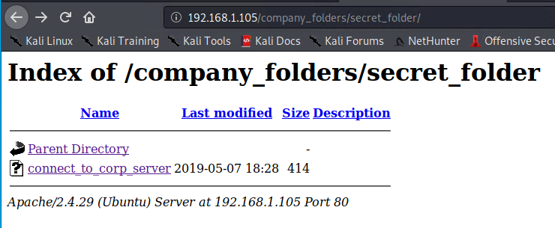
Exploitation: LFI Vulnerability
01
02
03
Tools & Processes
We began by exploring the site to find hints of its location.
After finding multiple files point to being moved to the secret folder and its location.
We then put “company_folders/secret_folder/” at the end of the url leading to a login
Achievements
Through this exploit we could be one step closer to finding confidential information and possibly other vulnerabilities we could use to attack the system.
URL
192.168.1.105/company_folders/secret_folder
Result

Slide 9
Exploitation: Brute Force Attack Vulnerability
01
02
03
Tools & Processes
Using Hydra we input Ashtons name and set a list of passwords to try.
Running it gives us their password
We find a file describing how to access their webdav
There is also a hash that we crack using another website.
Achievements
From this exploit we have gained information of how to access their webdav while also collecting a password for the CEO, Ryan.
Command
Hydra -l ashton -P usr/share/wordlist/rockyou.txt -s 80 -f -vV 192.168.1.105 http-get /company_folders/secret_foulder
Results

Slide 10
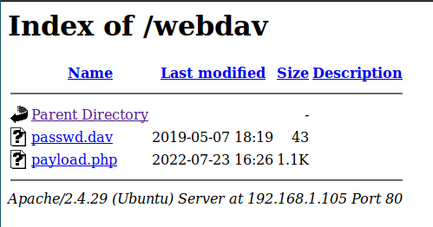
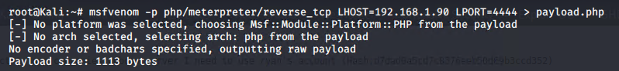
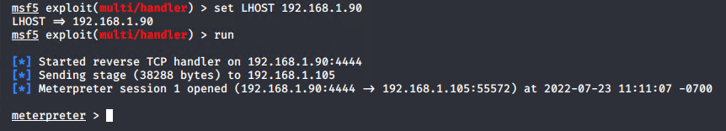
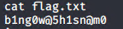
Exploitation: PHP Reverse Shell Vulnerability
01
02
03
Tools & Processes
Using the information we gathered from the brute force we access the webdav
We insert a php file we made in msvenom into the webdav
We set up a listener in metasploit
Opening the php in the webdav grants us a shell connected to the vulnerable machine
Achievements
Using this we are able to access the capstone computer in full and explore all files on it. We are then able to find the flag set for us. This is found in the root directory in flag.txt
Results

Slide 11

Blue Team
Log Analysis and Attack Characterization
‹#›

Slide 12

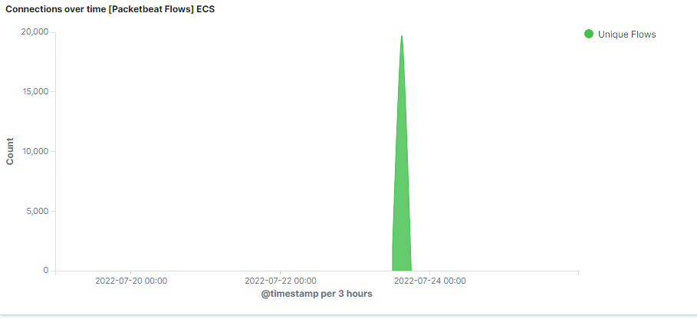
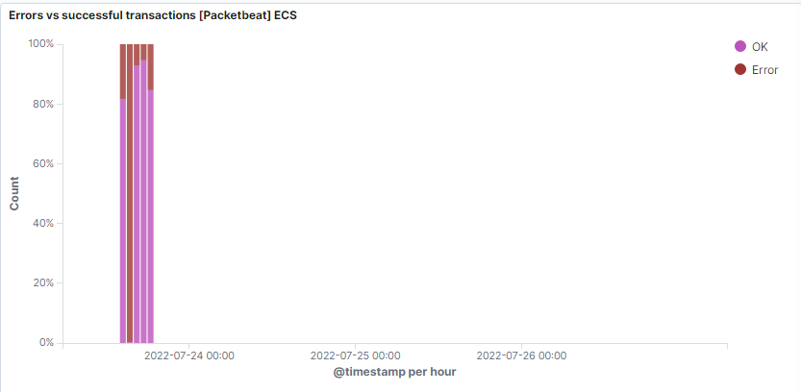
Analysis: Identifying the Port Scan
Answer the following questions in bullet points under the screenshot if space allows. Otherwise, add the answers to speaker notes.
What time did the port scan occur?
How many packets were sent, and from which IP?
What indicates that this was a port scan?
Notes:
The port scan began on 7/23 at 15:00
16,721 attempts were made from the IP 192.168.1.90
This is a port scan due to the amount of connections and failures to connect at the same time.

Slide 13
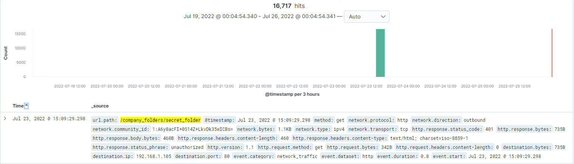
Analysis: Finding the Request for the Hidden Directory
Answer the following questions in bullet points under the screenshot if space allows. Otherwise, add the answers to speaker notes.
What time did the request occur? How many requests were made?
Which files were requested? What did they contain?
[Insert Here]
Include a screenshot of Kibana logs depicting the request for the hidden directory.
Notes:
The requests occurred between 7/23/22 at 14:00 and 15:10. 16,717 requests were made due to the attacker accessing the folder as well as the brute force requesting it.
The folder requested was the Secret Folder found in Company Folders. It contained the file describing how to access the webdav and the hash for Ryans password.

Slide 14
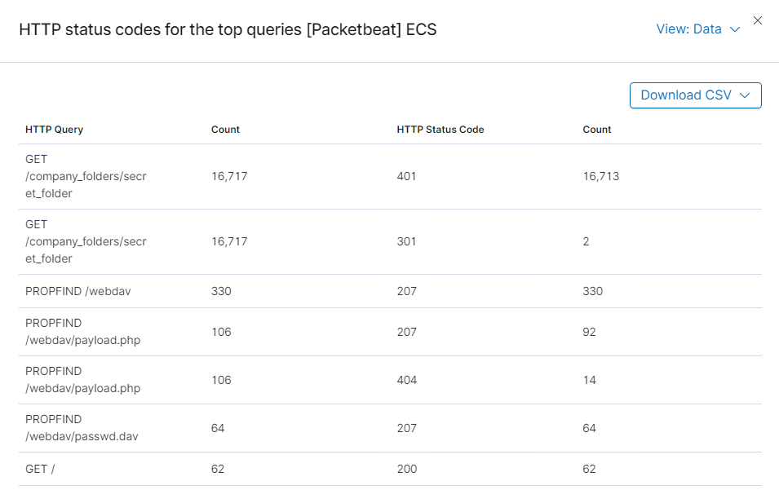
Analysis: Uncovering the Brute Force Attack
Answer the following questions in bullet points under the screenshot if space allows. Otherwise, add the answers to speaker notes.
How many requests were made in the attack?
How many requests had been made before the attacker discovered the password?
Notes:
Over the whole attack the request was made 16,717 times
16,713 attempts were made before the attacker found the password

Slide 15
Analysis: Finding the WebDAV Connection
Answer the following questions in bullet points under the screenshot if space allows. Otherwise, add the answers to speaker notes.
How many requests were made to this directory?
Which files were requested?
Notes:
The directory was requested a total of 544 times
The files accessed were the password.dav as well as the php file that was used to get a reverse shell.

Slide 16
Blue Team
Proposed Alarms and Mitigation Strategies
‹#›

Slide 17
Mitigation: Blocking the Port Scan
What kind of alarm can be set to detect future port scans?
We can purposely leave a port open that when it is requested we know it was due to a port scan only
What threshold would you set to activate this alarm?
For the above even a single request can mean that a port scan is going on.
What configurations can be set on the host to mitigate port scans?
Firewall: Adding this can allow you to decide what is visible and what is not while also providing automated security against attacks
TCP Wrapper: These act as a gate that only allow certain IPs to access certain ports.

Slide 18
Mitigation: Finding the Request for the Hidden Directory
What kind of alarm can be set to detect future unauthorized access?
We could use two different alarms. The directory is bound to have traffic so setting a threshold of activity or connections will serve as one. Another would be to set an alarm that if an IP outside of a whitelist will trigger another alarm.
What threshold would you set to activate this alarm?
For the first alarm I would set it to over 50 connections seeing how few people have access to this directory and how many connections we saw in the attack. The second alarm would trigger as soon as one forign IP was detected
What configuration can be set on the host to block unwanted access?
A way to prevent this entirely would to no longer keep the secret_folder directory on the local system and move it to a database accessible by those who still need the directory.
With it no longer being on the local machine, it becomes impossible to use LFI to access the directory.

Slide 19
Mitigation: Preventing Brute Force Attacks
What kind of alarm can be set to detect future brute force attacks?
A good alarm for this situation would be to trigger when an excessive amount of login attempts are made that come back with the incorrect login
What threshold would you set to activate this alarm?
I would need a better baseline to make a good threshold but over 40 logins would see the attack the site went though.
What configuration can be set on the host to block brute force attacks?
A rule could be set that could lock user accounts after so many failed attempts and putting a timer until they can attempt again.
This would severely slow down the attacker making their over 16,000 attempts take weeks. By that time proper actions would be taken against the attacker

Slide 20
Mitigation: Detecting the WebDAV Connection
What kind of alarm can be set to detect future access to this directory?
We can set an alarm to trigger when an unknown IP accesses the webdav or one for excessive activity/access to the webdav
What threshold would you set to activate this alarm?
In the attack, the webdav itself was accessed over 350 times. Setting a threshold for 50 would be a good start without further data
What configuration can be set on the host to control access?
First would to not have a hash of Ryan's password on the web server.
Second would be to add folder permissions. Preventing anonymous users from opening the webdav regardless of passwords they have.

Slide 21
Mitigation: Identifying Reverse Shell Uploads
What kind of alarm can be set to detect future file uploads?
For this we could set up scheduled times to upload files into the webdav and anytime outside of that could be a warning.
What threshold would you set to activate this alarm?
For this any upload outside of scheduled times should trigger an alarm
What configuration can be set on the host to block file uploads?
We can prevent file execution within the webdav itself as long as it is not needed to display web pages.
We could also disallow the uploading of the PHP file type to prevent future attempts at this vulnerability.

